Slide 1



Development of STAR EPICS VM Environment
Jiro Fujita, Charles Costello, Ryan Gnabasik
Creighton University/STAR Collaboration

Slide 2
The Motivation
Ease of installation for newcomers
Controlled environment
Developed projects can be saved on the disk
Can be used for prototype development by the remote collaborators
Keep the package relatively generic such that anybody can use it

Slide 3
STAR Collaboration/Creighton University
STAR (Solenoidal Tracker At RHIC @ BNL) is a large physics collaboration with very few EPICS developers
  No full-time EPICS developers
Creighton is responsible for STAR Slow Control
  One of our task is to teach students through research
STAR subdetector upgrade is handled by other institutions in collaboration with Creighton Control Group

Slide 4
Pre-build EPICS Distributions
KEK Mini-EPICS
INFN LivEPICS
NSLS-II Debian packages
SNS MacOS X EPICS Channel Access Client Installer
APS Virtual Linac
Others??

Slide 5
Past Students…
Try to setup EPICS on their computers
  Not always easy, as most students have almost no experience in Unix environment
Setting up extra computers somewhere for them to use
Live CD editions (LivEPICS by INFN or miniEPICS by KEK)
  Give the CD to students, tell them how to use
  Worked well, but started to see students with Macs rather than Windows…
  Newer computers sometimes have issues booting correctly from older boot CDs…

Slide 6
EPICS Virtual Machine Environment
Originally intended only for the internal use at Creighton (not even among the STAR collaboration)
Not exactly a new idea itself, but freely available to anybody
Inspired by miniEPICS (KEK) and LivEPICS (INFN)
As long as the host computer is x86 architecture, EPICS VM should work regardless of the host OS
We chose VirtualBox, as it is free
  No extra financial burden for students
Enables consistent set of tools and interface, etc
  Excellent for newcomers with minimal experience with Linux

Slide 7
EPICS VM in Action
Used by two undergraduate to learn EPICS basic this spring semester
  Made it possible for the students to learn how to use EPICS without worrying about how to do the initial setup, which is somewhat irrelevant in their level
Contains enough tools for them to develop and learn the EPICS basic including MEDM, Asyn, VDCT and sequence

Slide 8
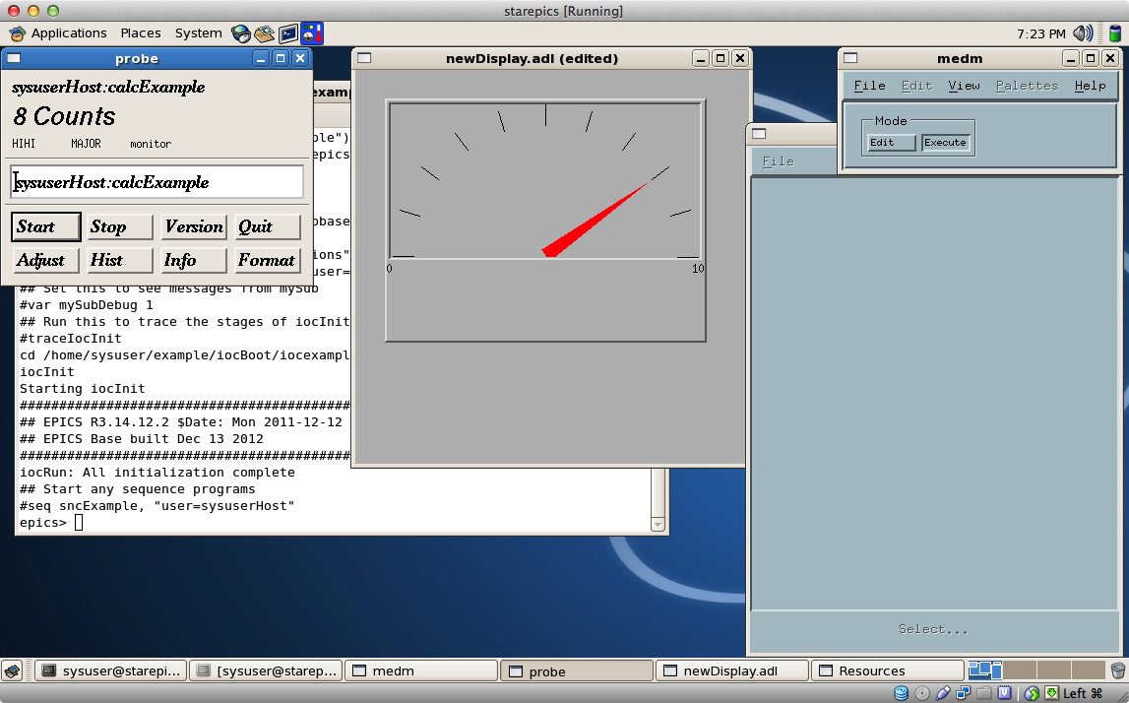
STAR EPICS VM MEDM & Probe

Slide 9
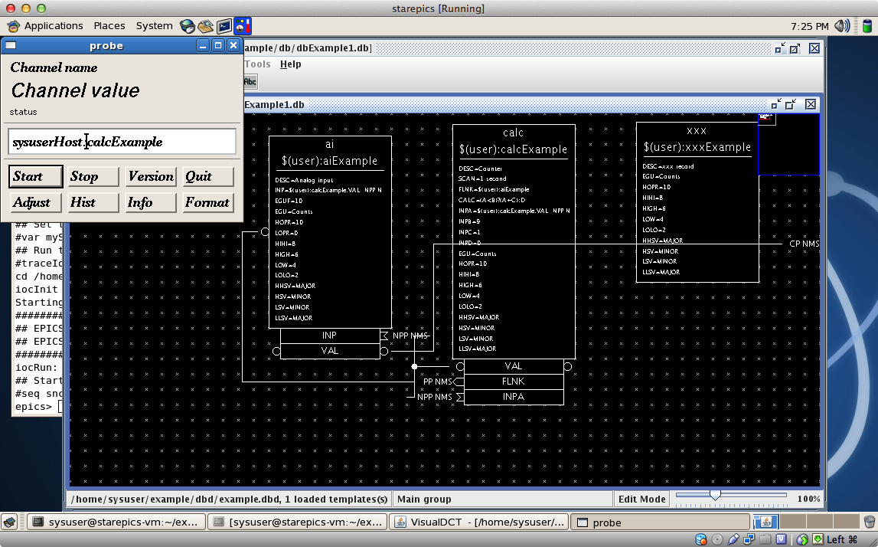
STAR EPICS VM Probe & VDCT

Slide 10
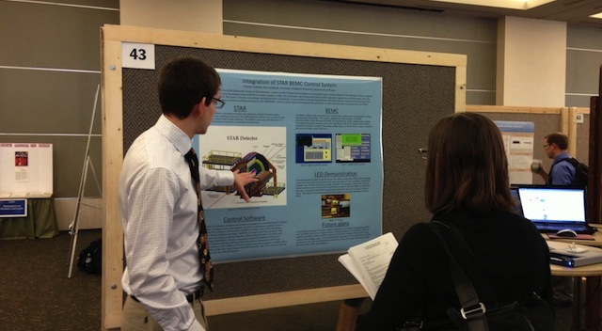
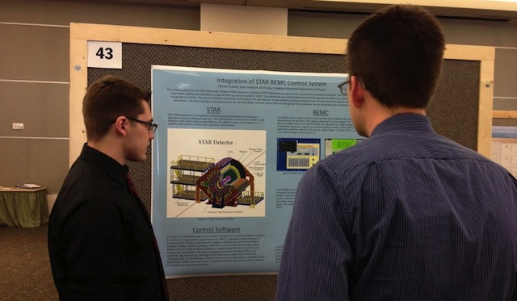
Students Presentation @ Creighton

Slide 11
Performance Test
Performance Test was done by using EPICS Base Regression Test Suite
  a chain of 103 calc and ai records which are all forward-linked together using database links. It measures that 1000 times, and reports the total and average time for the processing chain
Real Linux machine (Scientific Linux 5.8, Quad core Core i5-3.1 GHz)
  totalTime= 0.07985 sec 12,822.98 processes/sec
EPICS VM (Host OS: MacOS X 10.8, Dual core Core i7 2.7 GHz)
  totalTime=0.09390 sec 10,649.12 processes/sec
Older Performance record (8-core Xeon-2.0GHz, RHEL 5.4)
  totalTime=0.09014 sec 11,093.73 processes/sec

Slide 12
Possible Future Plan
Adding other EPICS tools?
  EDM (likely coming soon)
  CSS
  ALH
  ChannelArchiver
  caxy ssh proxy
Headless version for soft IOC use
  Early in development

Slide 13
How to get EPICS VM?
Available from Creighton server:
http://physicsweb.creighton.edu/jiro/VirtualBox/
  Brief instruction on how to setup is available as well
  Link is also available from EPICS home page, under “Distribution” section
Requires to send me an e-mail to get the login and password
  Not exactly a secret, but I would like to know if anybody is actually interested

Slide 14
Conclusion
Based upon two undergraduate students’ experience this spring, it was fairly favorable to use EPICS on VirtualBox as a tool for newcomer
Performance isn’t all that bad, given right configuration host computer

Slide 15
Special Thanks
Department of Energy Office of Science
Creighton University College of Arts & Science
EPICS collaboration

